Slide 1

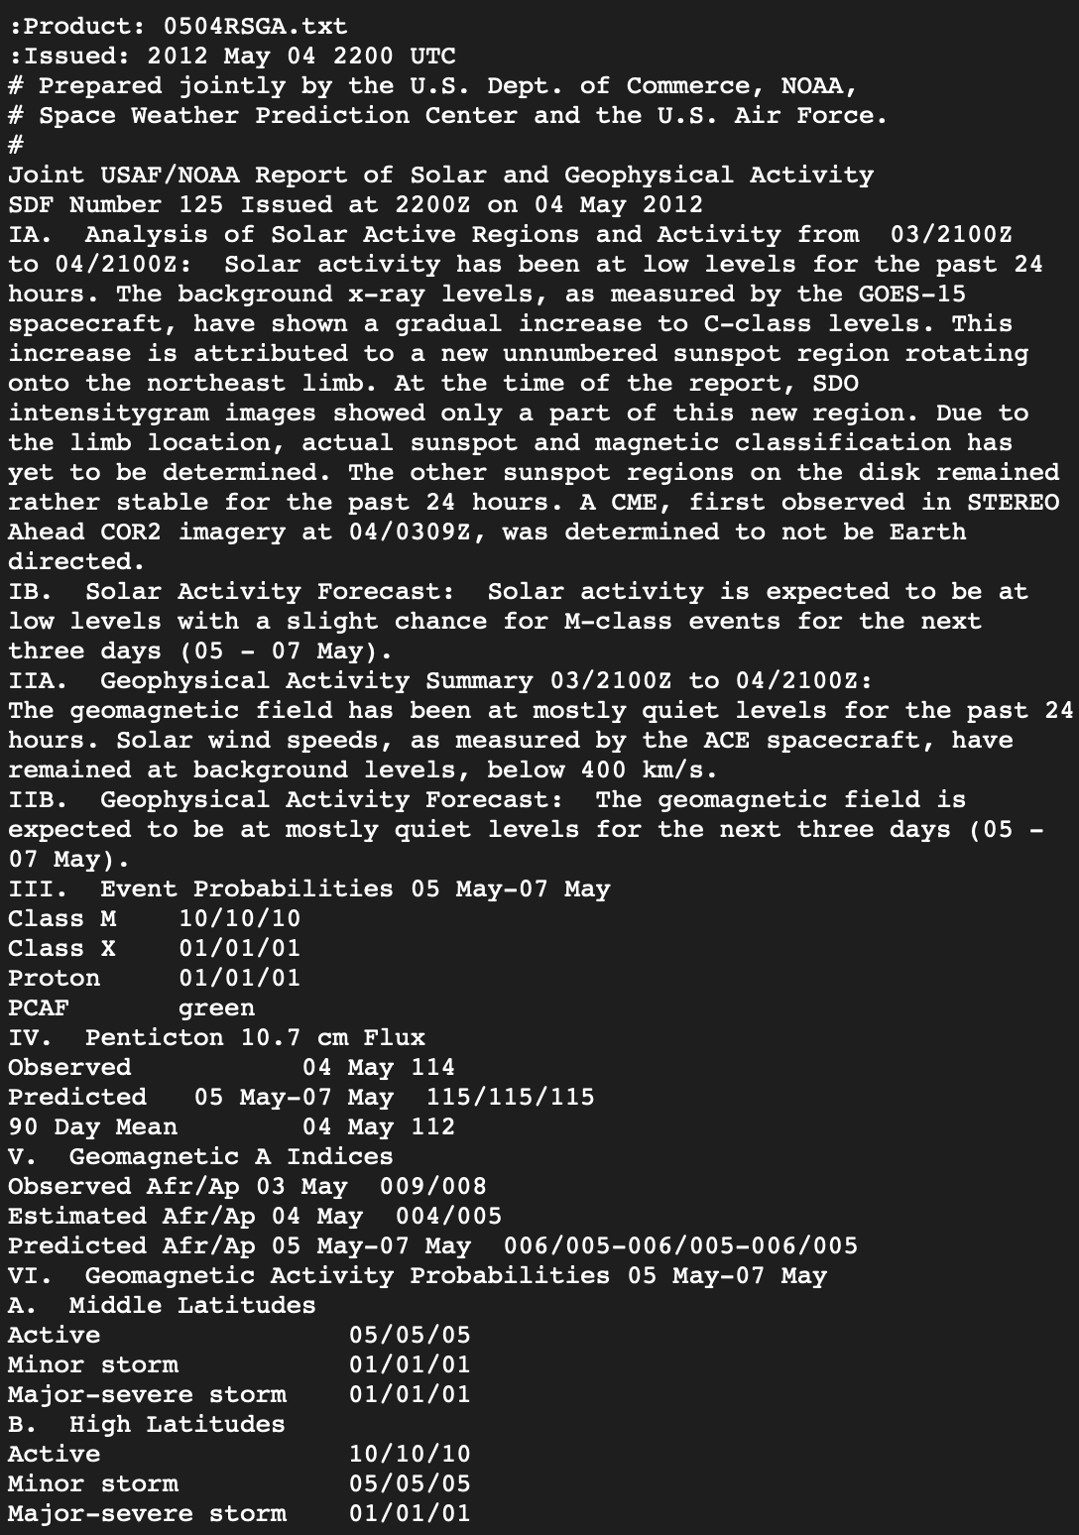
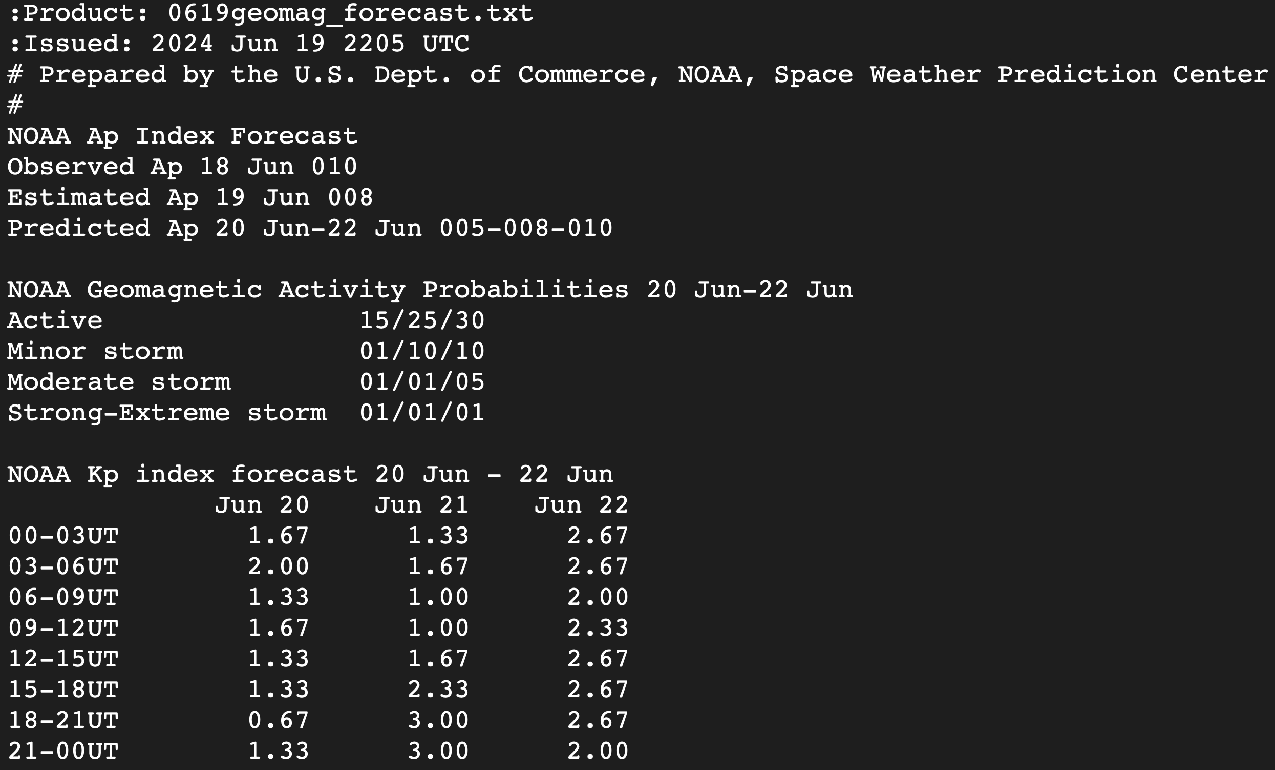


Verification of SWPC Kp and F10.7 Space Weather Forecasts
Henry Jordan¹, Tomas Berger², Andong Hu¹
¹Space Weather Technology, Research and Education Center, University of Colorado, Boulder, CO, USA,
²National Center of Atmospheric Research High Altitude Observatory, Boulder CO, USA
Introduction
Forecast verification is the process used to quantify the performance of a forecast. It’s utility is two-fold. First, it allows both forecasters and end users to better understand the strengths and weaknesses of the forecast to make more informed decisions. Second, it allows those who develop forecasts to have a benchmark to compare to when determining if their forecast is better than the current operational forecasts.
Why Forecast verification is important
Need to understand how well a forecast is performing in order to use it well
Need to have models quantified so we can compare to new models that we are building
Background on space weather
In space weather forecasting we don’t just want to predict what solar events will happen but also the impacts that the events will have on the earth and near earth environment
Key part of this is predicting space weather drivers such as Kp index and F10.7
Methodology
SWPC releases a variety of reports containing various space weather information and forecasts. We focused on reports containing Kp and F10.7 Forecasts.
SWPC releases 3-day forecast of Kp and 7-day forecast of F10.7
Test Result and Analysis
To measure model performance we compute the RMSE between the forecast and the actual result
We also compute the true skill score
We examine report performance during all times and storm times Kp > 5
We compare performance to low effort baseline models, persistence and recurrence
Photo of availability of 3-day forecast and RSGA
Kp RMSE
Kp RMSE during storm
F10.7 Analysis
Kp TSS
$$Precision=\frac{TP}{TP+FP}$$
$$Recall=\frac{TP}{TP+FN}$$
$$TSS=\frac{TP\left(TN+FP\right)+TN\left(TP+FN\right)−(TP+FN)(TN+FP)}{(TP+FN)(TN+FP)}$$
Results
Conclusion & Future Work
Establish benchmark
This work is supported by the National Natural Science Foundation of China (NSFC) (project ID: 41730109) and the Jiangsu dual creative talents and teams programme projects awarded in 2017. This work is also supported by the Australian Research Council (ARC) project (LP160100561). The China Scholarship Council (CSC) is gratefully acknowledged for its provision of a scholarship for Andong Hu's PhD study at the SPACE Research Center, RMIT University. We also thank UCAR/CDAAC for providing ionPrf data, and OMNIWeb for providing the Kp and R10.7data.
Notes:
1

